Slide 1
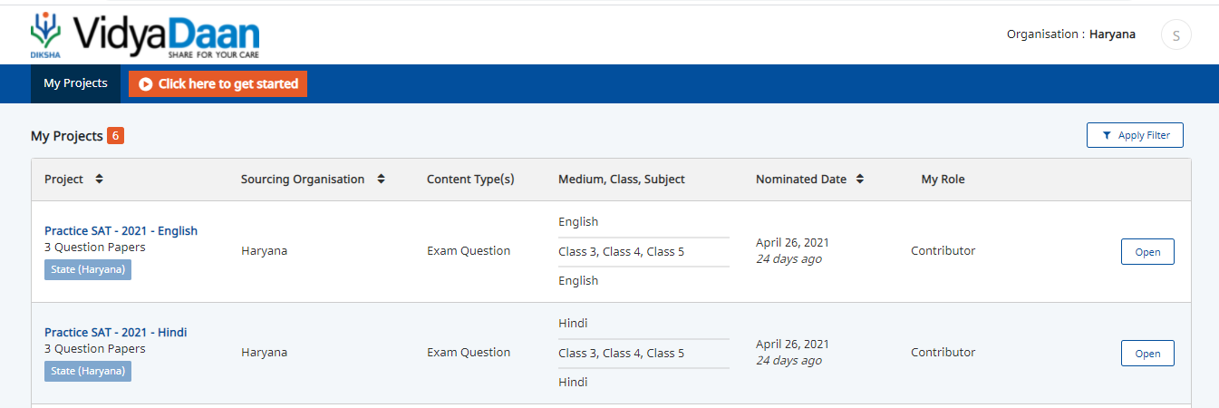
Question Library Workflow - Implementation Approach
1. Contributor wants to add questions to a collection under the Project – “Practice SAT 2021- English”

Slide 2
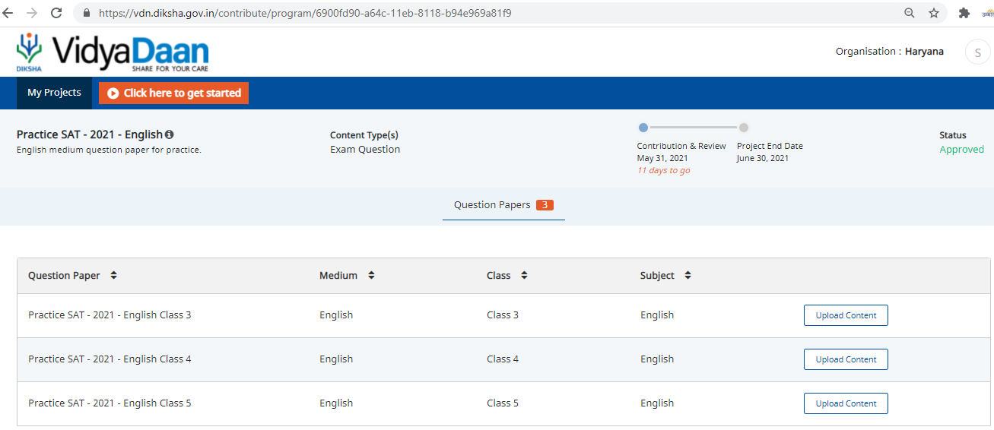
Practice SAT 2021 English
Grade - 1
Grade - 2
Grade - 3
1. Contributor wants to add questions to a collection called – Grade 1

Slide 3
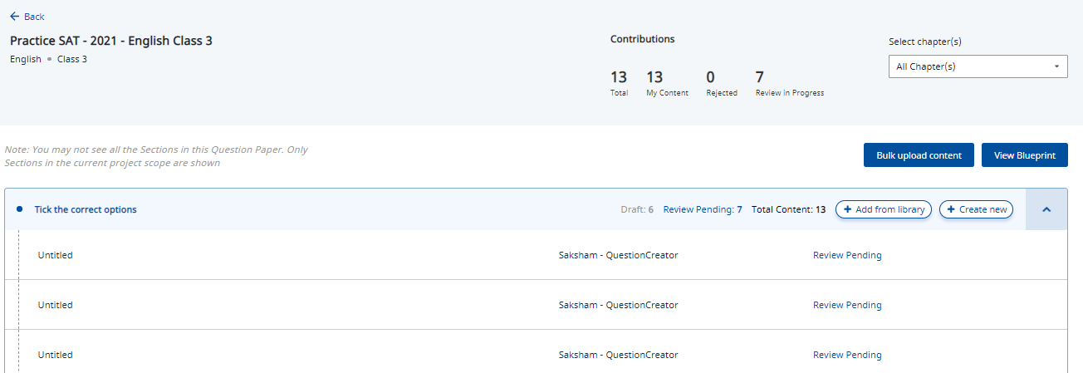
1
User clicks on view content, user can download questions
1. Contributor wants to add questions from the library to the collection.

Slide 4
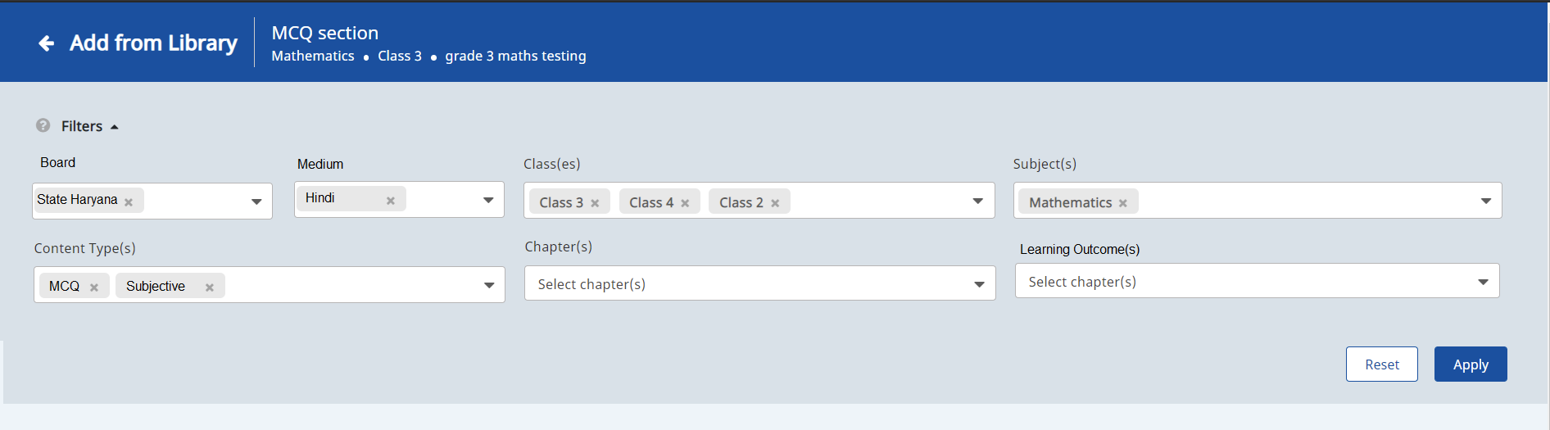
On clicking on “Add to library option” , the contributor can filter questions based on subject, grade, content type (question paper set), chapters, competencies, question type (Asset nomenclature to be changed to question type – MCQ/VSA/ LA etc)
The filter will be a multiselect filter and user should have the provision to apply multiple filters at a time
After clicking on Apply button, the questions should get filtered based on the filter selections.
The user can either select questions 1 by 1 or choose “Select All” option to add all questions
5. After adding relevant questions, user can click on back to return to the list view of questions of collection screen.

Slide 5
On returning to the question paper set collection screen, list of questions added by the user from the library get listed in the question list view.
The user also has the provision to create new questions by clicking on “Create New” button.

